Slide 1
Topic 1
Essential Chemistry Skills
Pearson Ch 9
Lucarelli Ch 4.1-4.3, 6.1-6.2, 10
STAWA Set 7, 13, 22-24
Materials
Pearson Ch 1
Lucarelli Ch 3
STAWA Set 4, 6
The atom, nucleus and electrons
Pearson Ch 2, 3
Lucarelli Ch 1.7-1.11, 2, 7
STAWA Set 8-9
Periodic Trends
Pearson Ch 3.3
Lucarelli Ch 9
STAWA Set 10-11

Slide 2
Topic 2
Bonding Weeks 6-8
Empirical Formula Week 9
Intermolecular forces Week 10
Solutions Weeks 1-3

Slide 3
Topic 2
Bonding
Pearson Ch 4-7
Lucarelli Ch 8
STAWA Set 12-18
Empirical Formulae
Pearson Ch 9.4
Lucarelli Ch 4.4-4.6
STAWA Set 25
Intermolecular Forces
Pearson Ch 12-13
Lucarelli Ch 15, 19
STAWA Set 19-20
Solutions
Pearson Ch 15-16
Lucarelli Ch 16
STAWA Set 27-28

Slide 4
Bonding
Lucarelli Chapter 8

Slide 5
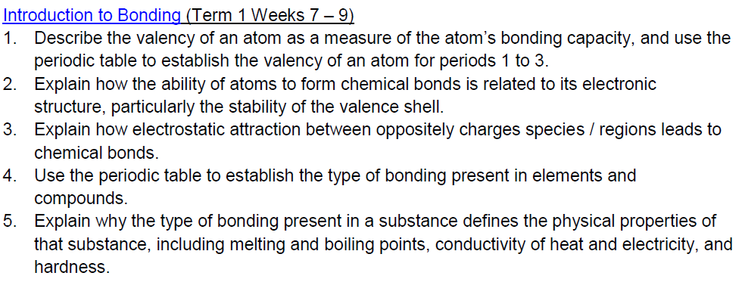

Slide 6
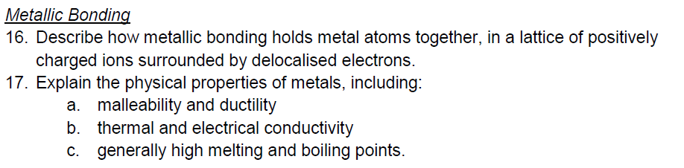

Slide 7
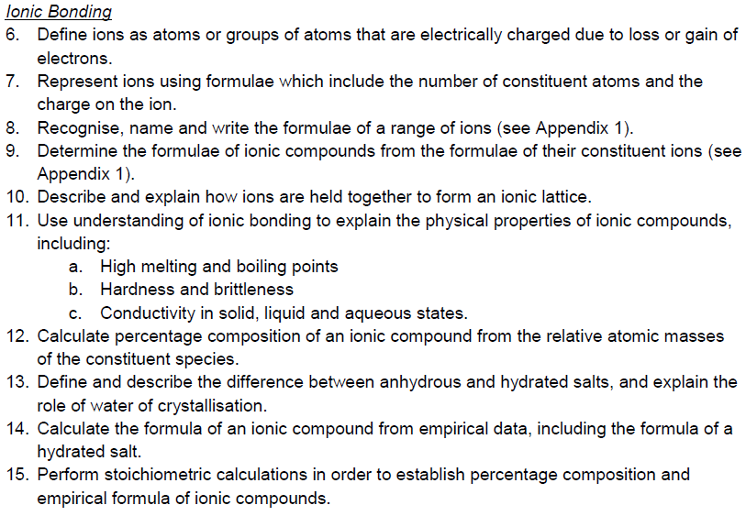

Slide 8
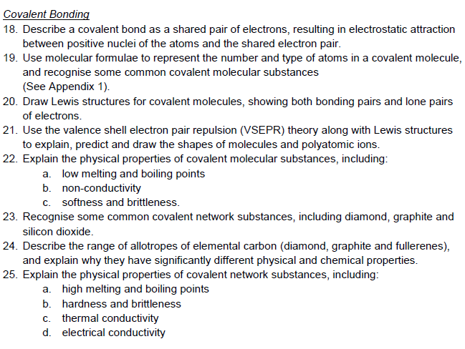

Slide 9
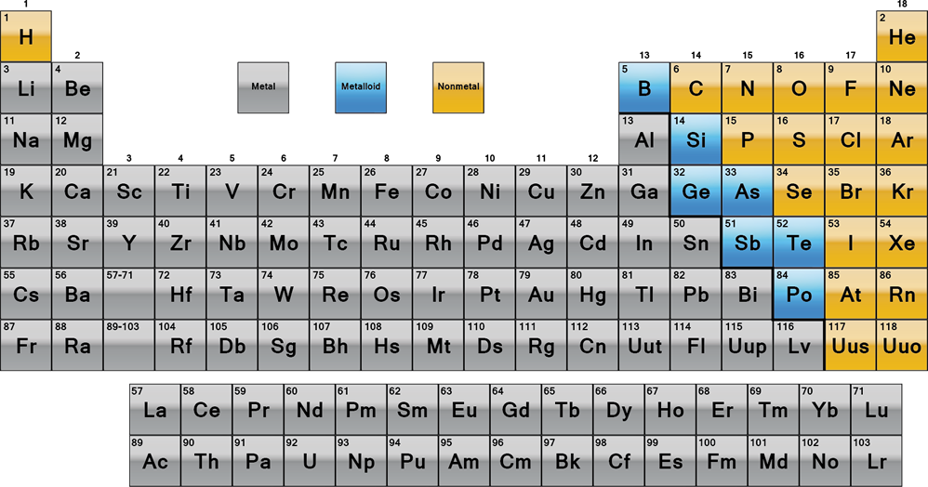
Introduction

Slide 10
Valency
Atoms tend to form chemical bonds to obtain a filled valence shell and become chemically stable.
Chemical bonds are due to the electrostatic force of attraction between positive and negative charges in participating atoms.
Valency is the combining power of an atom and is equal to the number of hydrogen atoms that an atom could combine with or displace from a compound.

Slide 11
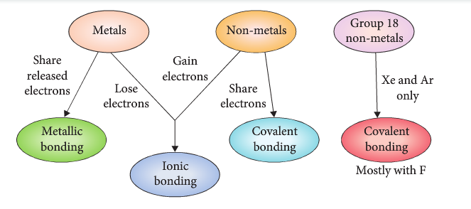
Types of Bonding

Slide 12
Metallic Bonding
Metallic bonding is the strong attraction between closely packed positive metal ions and a 'sea' of delocalised electrons

Slide 13
Properties
See Pearson for Table of properties

Slide 14
Ionic Bonding
Atoms lose or gain electrons to form charged ions
Cation (+)
Anion(-)
Oppositely charged ions are attracted to one another
An electrostatic attraction between a lattice of positively and negatively charged ions – ionic bonding

Slide 15
Ionic bonding properties
See Pearson for table of properties

Slide 16
Naming Ionic Compounds
CuSO₄
NaCl
RbOH
CaCO₃
Ba(NO₃)₂
NH₄Br
FePO₄
FeSO4
Cobalt (II) hydroxide
Sodium oxide
Potassium nitrate
Ammonium phosphate
Silver (I) fluoride
Molybdenum (V) sulfate
Stop, Drop and Swap

Slide 17
Lewis Dot Diagrams
Absolute Classic #17
H₂CO₃
H₃O⁺
IO₃⁻
NO₂⁻
N₂O₄
CHCH
Extension
XeF₄ (Xe 12 e-)
BH₃ (B 6 e-)
NO₄⁻ (N 8 e-)

Slide 18
Lewis Structures Practice
Lucarelli Chapter 8 (Sets 10-12)
Pearson Chapter 4, 5, 6
STAWA Sets 13-17

Slide 19
Valence Shell Electron Pair Repulsion (VSEPR)

Slide 20
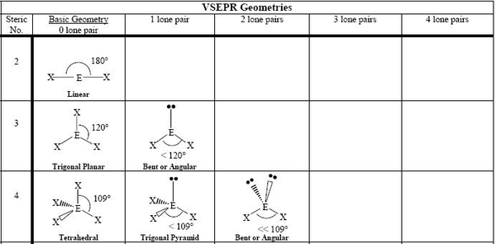

Slide 21
Covalent Lattices and Networks
Pearson Chapter 7

Slide 22
Allotropes
Some elements exist with their atoms in several different structural arrangements called allotropes.
Atoms are bonded to each other in different specific ways.
E.g O₂ and O₃

Slide 23
Diamond: continuous 3D network structure
Graphite: continuous 2D layer lattice
See Pearson for Table of properties
Charcoal: heterogenous structure

Slide 24
Carbon Nanomaterials
Pearson Chapter 7

Slide 25
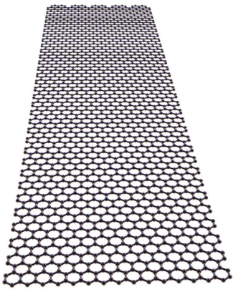
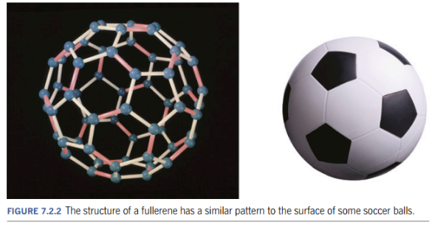
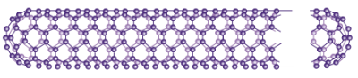
Fullerenes
Graphene
Carbon Nanotubes

